Slide 1



aHEALTHYme REWARDS
GET HEALTHY.
GET REWARDED.
®´
Blue Cross Blue Shield of Massachusetts is an Independent Licensee of the Blue Cross and Blue Shield Association.
Notes:
BCBSMA has partnered with Virgin Pulse, an independent company, to offer ahealthyme Rewards, a dynamic digital health engagement program with easy-to-earn rewards. This program is focused on wellness being done for you not to you because we know that everyone is at a different place in their well-being journey.
And as a Blue Cross subscriber, it’s available to you at no cost.

Slide 2
Earn up to $400 every year,
just for making healthy choices.
2
BLUE CROSS BLUE SHIELD OF MASSACHUSETTS | CONFIDENTIAL – NOT FOR DISTRIBUTION
2
Notes:
It should be easy to make your healthy choices pay off but we know it’s not always easy. That's why ahealthyme Rewards offers up to $100 per quarter – or $400 per year – and they assist you with staying on top of your health.

Slide 3
Focused on
Well-being
Track your healthy
habits and work toward
your personal health and
wellness goals.
Friendly
Competition
For a little extra
motivation, join challenges
to compete with friends, family, and co-workers.
Big
Rewards*
It’s easy to turn your
healthy habits into points—and just as easy to get
your rewards!
3
Notes:
With a focus on your overall well-being, you get points as you work toward your personal health and wellness goals, completing daily tasks to build lifelong habits.
Looking to get your competitive juices flowing? Join a quarterly team challenge or create a more personal one to compete against other users and see who comes out on top. It's all about making healthy choices fun and rewarding.
And because everyone should get rewarded for being healthy, ahealthyme Rewards is available in 20 different languages. You can select the right one for you upon registration.

Slide 4
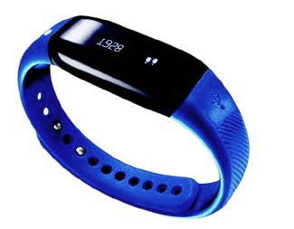
1.
GET STARTED
Sign up at ahealthymerewards.com, and get
a Max BuzzTM Activity Tracker at no cost.
Then, download the Virgin Pulse®´´ app and connect your activity tracker to your profile.
HERE’S HOW IT WORKS
2.
EARN POINTS
Log your steps, complete wellness journeys, and track other healthy habits to earn points daily.
3.
GET REWARDED
As you earn points, you get rewarded.
The best part? You can use them right away!
4
Notes:
It’s simple to get rewarded when you make healthy choices. Here’s what you need to do:
Sign up for ahealthyme Rewards at www.ahealthymerewards.com. Once you do, if needed you can order a free blue branded Max Buzz Activity Tracker at no cost to track your steps and sleep.
As a new user you will see a daily card on your homepage to order your blue branded max buzz or enter the Virgin Pulse store and go under featured products. Once you add it to your care and are ready to pay the fee will be $0 unless you have previously ordered one.
2. Next, track daily healthy habits, participate in quarterly, monthly or personal challenges, and reach health-related milestones like logging 10,000 a day for 20 days in a month to earn points.
3. Then after completing goals and reaching specific point amounts, you will automatically get your rewards—and you can even redeem them as you earn them. No waiting until the end of the year!

Slide 5
EARN UP TO $400 YOUR WAY
You choose what you want to work on, and get rewarded for it.
Get in the habit
Log your steps, track up to three healthy habits
of your choice, complete your cards, and more to earn points daily. Do these every day and watch rewards for your health and your wallet pile up.
Meet your Milestones
Earn points when you achieve monthly and
annual milestones like reaching 10,000 steps on
20 different days within the same month or logging your sleep 20 times in a month.
EXCLUSIVE REWARDS FOR BLUE CROSS SUBSCRIBERS
As a subscriber, you also earn points for your routine health checkup,
preventive cancer screenings, and flu shot.
5
Notes:
With ahealthyme Rewards, there are over a 100 ways to earn. Here are just a few of them:
Use your connected device to track steps and sleep.
You can use your no-cost Max Buzz Activity Tracker, Apple Watch, Fitbit, Strava, and more as it is multi-device compatible
Track up to three healthy habits of your choosing per day and read your daily cards.
Themes include getting active, eating healthy, sleeping well, reducing stress, learning new things, and many more.
Participate in Team and Personal Challenges.
There are also milestones built into the program that reward you for sticking to your health goals. Consistently beating your step goal throughout the month? Enjoy your points!
It also Rewards subscribers for engaging in their well-visit, preventive screening and flu shots.

Slide 6
Level up
04
03
02
LEVEL
01
LEVEL
LEVEL
LEVEL
Reach the 1,000-point threshold
RECEIVE
$10
Reach the 5,000-point threshold
RECEIVE $30
Reach the 12,000-point threshold
RECEIVE
$60
Reach the
18,000-point threshold
RECEIVE $10O
6
Notes:
The Rewards program is built on quarters and is not an all or nothing program as we know some days are better than others.
Completing activities and earning points will help you achieve levels. When you reach these point thresholds, a dollar value will be put into your Rewards bank.
At the end of the quarter, all points will reset but any money you earned will remain until you choose to redeem it.

Slide 7
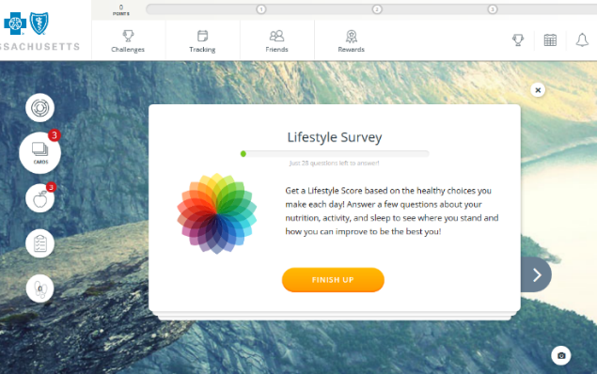

7
Notes:
Now I want to share a quick 3-minute program to show you more.
Show experience of logging in, completing cards, and logging steps. Link: https://www.youtube.com/watch?v=gB-965UAR_k

Slide 8
TIP #1: USE YOUR ACTIVITY TRACKER.
Get 200 points just for connecting your device, plus earn
more for your steps when they’re logged through your tracker.
TIP #2: CUSTOMIZE YOUR PROFILE.
Your first 100 points are the easiest—all you need to do is
sign up. Get another 100 for adding a profile picture, and
200 more when you set your well-being goal.
TIP #3: COMPLETE YOUR HEALTH PULSE CHECK.
Earn 1,000 points and get a snapshot of your well-being
when you complete the Health Pulse Check, an online questionnaire about your overall health.
Expert Tips for Quick Rewards
8
Notes:
Just minutes after signing up, you can be raking in the rewards. Here are some expert tips that will have you earning in no time.
Connect your tracking device and earn 200 points – as mentioned earlier, the program is multi-device compatible so use your apple watch, Garmin, Fitbit or Strava app to sync your activity
Customize your profile – the program is meant to be a personal journey, so the more information you provide about yourself and your areas of focus the more targeted the information will be
Complete your health pulse check – if you don’t know where to start this is a good place. It will assess your current health and lifestyle risks and guide you to which areas you should focus on

Slide 9
FOUR WAYS TO USE YOUR REWARDS
Shop the Virgin Pulse Store
GET GIFT
CARDS
DONATE TO
CHARITY
PUT IT IN
THE BANK
9
Notes:
You earned these rewards. You should be able to use them whenever and however you want.
That’s why ahealthyme Rewards lets you use your rewards as you earn them, so you don’t need to wait until the end of the year. And there are four different ways to use them.
Shop exclusive deals on wellness products, tech accessories, and more at the Virgin Pulse online store.
Turn your rewards into gift cards from some of the biggest brand names in retail, from Nike, Target, or Visa cards and beyond.
- Donate to charities like the Special Olympics, Habitat for Humanity, the Clean Water Fund, or a Charity on Top which directs you to local charities.
- Save it for a rainy day. You can deposit some or all of your rewards directly into your checking or savings account.

Slide 10
Time to start earning
STEP 1:
Sign up at ahealthymerewards.com.
STEP 2:
Download the Virgin Pulse app.
10
Notes:
It should be easy to make your healthy choices pay off. Don’t miss out and start earning today.
Sign up at ahealthymerewards.com - use the name that is associated with your BCBSMA medical plan
Once you do you will receive a welcome email and have access to a tutorial of the website.
Then, download the app and login for easy access…
Everything you can do on the webpage from tracking habits to joining and creating challenges to redeeming rewards can be done on the app.

Slide 11
QUESTIONS?
Virgin Pulse Member Service is here to help.
• Chat online at member.virginpulse.com, Monday through Friday,
2:00 a.m. to 9:00 p.m. EST
• Email [bcbsma@virginpulse.com]
• Call [1-844-854-7285]
* Wellness rewards may be considered taxable income. Consult a tax advisor.
® Registered Marks of the Blue Cross and Blue Shield Association. ®´ Registered Marks of Blue Cross and Blue Shield of Massachusetts, Inc.,
and Blue Cross and Blue Shield of Massachusetts HMO Blue, Inc. ®´´ Registered Marks and TM Trademarks are the property of their respective owners.
© 2022 Blue Cross and Blue Shield of Massachusetts, Inc., or Blue Cross and Blue Shield of Massachusetts HMO Blue, Inc.
Notes:
Thank you for your time
If you have any questions about the program, Virgin Pulse Member Service can help. Connect with them through online chat, by email, or call toll-free.

